Slide 1
DROWSINESS DETECTION

Slide 2
Drowsy driving
=
driving + sleepiness/fatigue

Slide 3
Use Case
1 in 25 adult drivers fall asleep while driving.
TNHTSA estimates that drowsy driving was responsible for
72,000 crashes,
44,000 injuries, and
800 deaths (approx. every year)

Slide 4
ARCHITECTURE

Slide 5
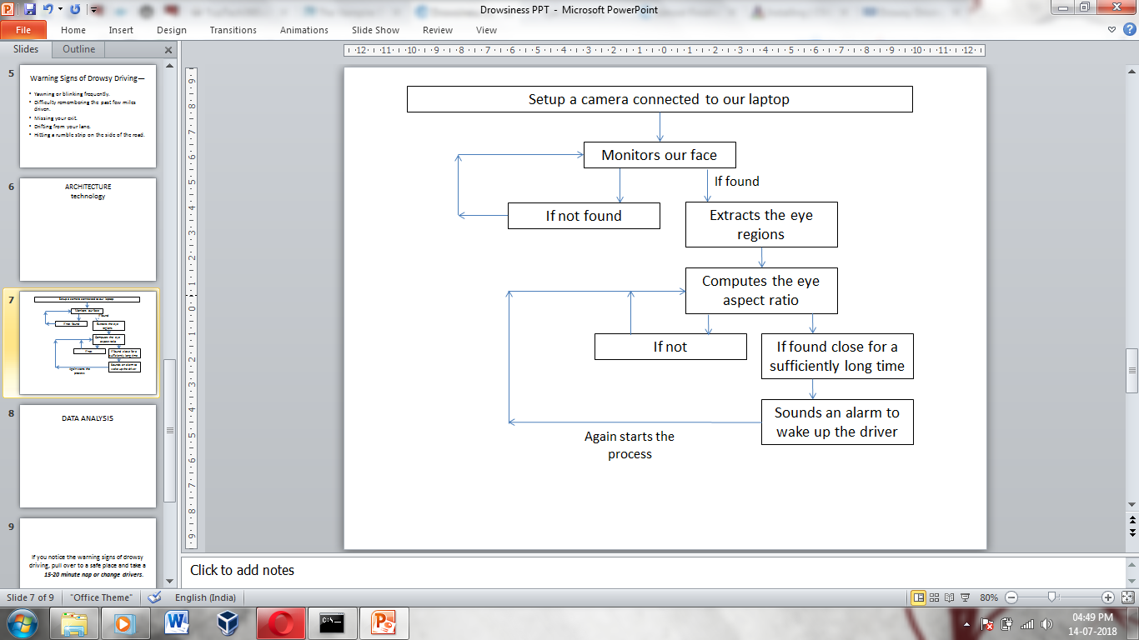

Slide 6
Setup a camera connected to our laptop
Monitors our face
If found
If not found
Extracts the eye regions
Computes the eye aspect ratio
If not
If found close for a sufficiently long time
Sounds an alarm to wake up the driver
Again starts the process

Slide 7
Technologies Used:
Opencv
Python
Machine Learning
Data Science

Slide 8
DATA ANALYSIS

Slide 9
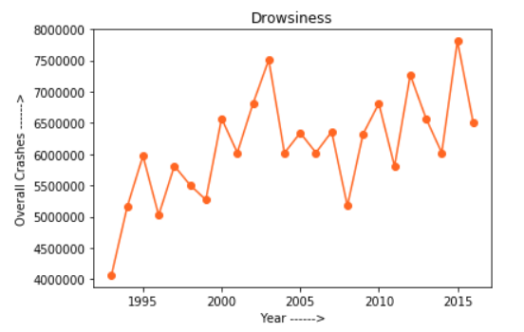
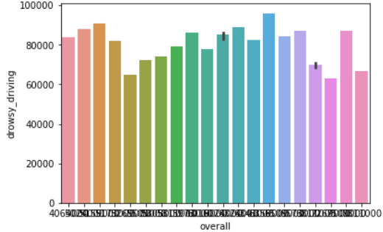
Overall Crashes v/s Year
Overall Crashes v/s Drowsiness

Slide 10
If you notice the warning signs of drowsy driving, pull over to a safe place and take a
15-20 minute nap or change drivers.

